Slide 1
AIML CA1: Part A Classification
Name: Glenn Wu
Admin No.: 2214395
Class: DAAA/FT/2A/01

Slide 2
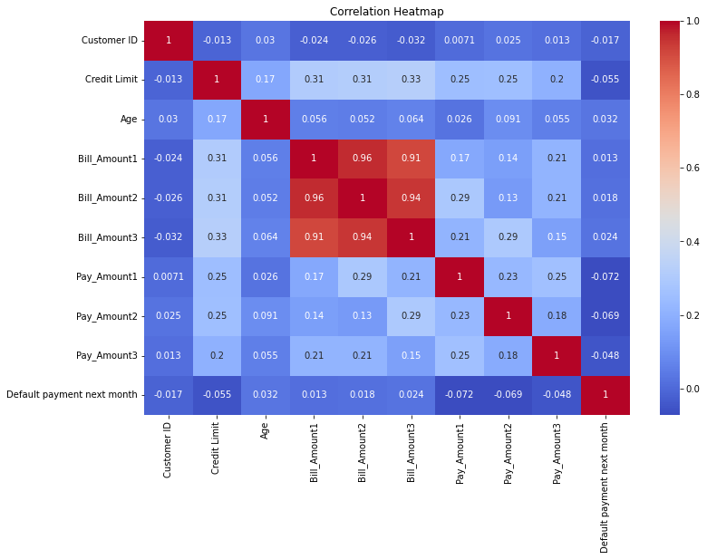
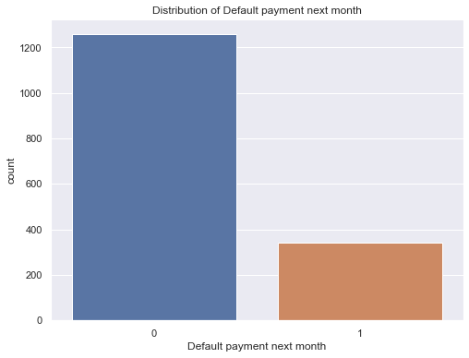
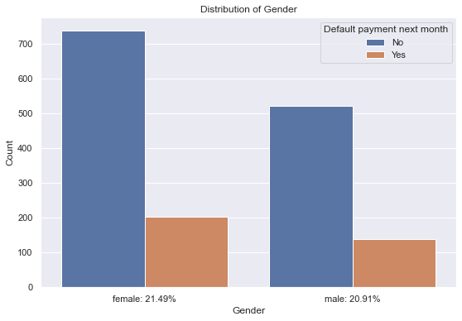
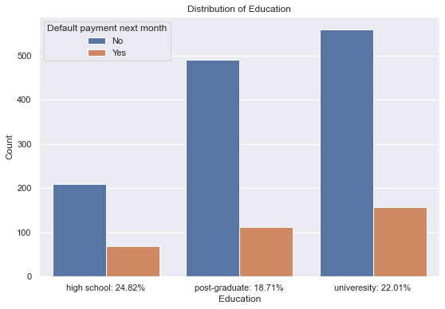
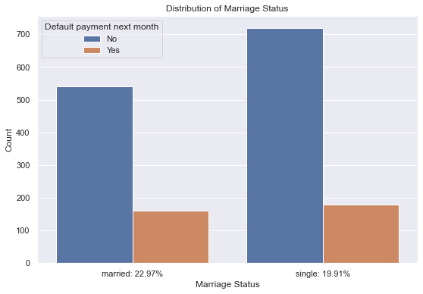
Data Exploration
The customer ID column is unique to each customer and independent from the rest of the columns, thus I will remove it.
We must predict whether a customer will default given certain information. There is an imbalance in the number of Positive (1) and Negative (0) classes.

Slide 3
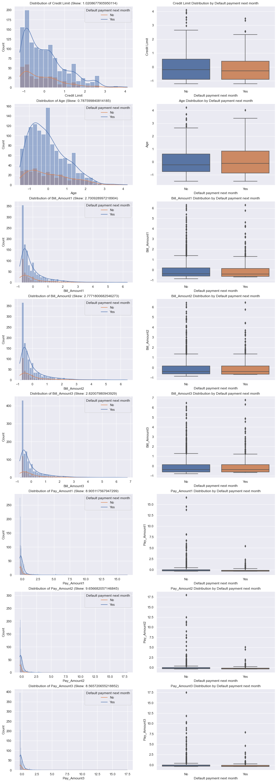
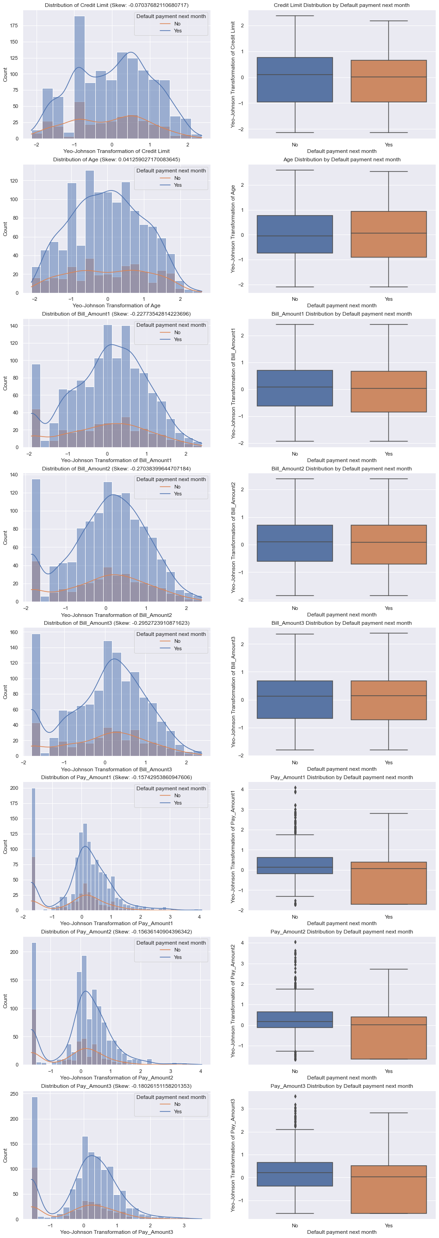
Data Exploration/Feature Engineering:
Yeo-Johnson Transformation
All the continuous numerical columns are highly skewed
After applying the Yeo-Johnson Transformation they are un-skewed (-0.5 < skew < 0.5)

Slide 4
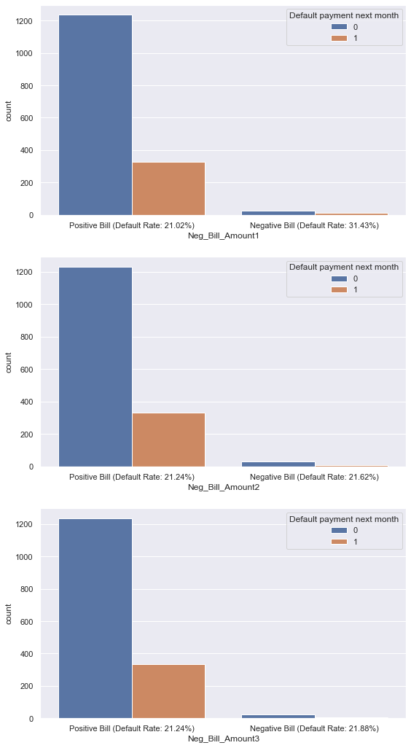
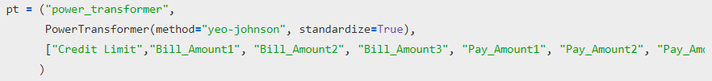


Data Exploration/Feature Engineering
Some rows in the Bill_Amounts are less than zero.
For Bill_Amount1, when the value is less than zero, there is a higher chance that the customer will default, 31.43% compared to 21.02% if they have a bill equal to or more than zero.
Thus, I also One-Hot encode this column
Usage example with pipeline:

Slide 5
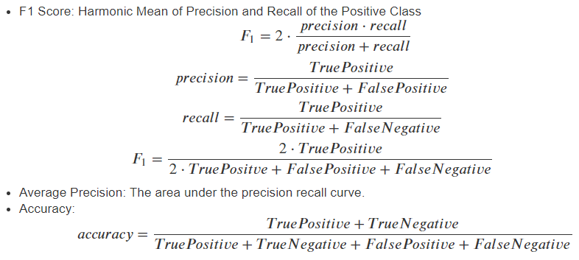
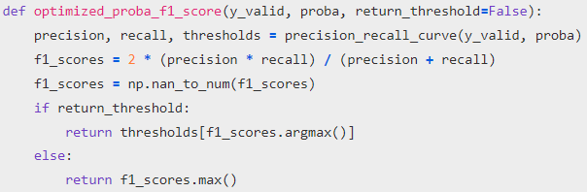
Model Selection
Scoring Metrics:
 | Predicted | Negative (did not default) | Positive (defaulted)
Actual
Negative (did not default) |  | True Negative | False Positive
Positive (defaulted) |  | False Negative | True Positive
Optimized Probability Threshold F1 Score

Slide 6
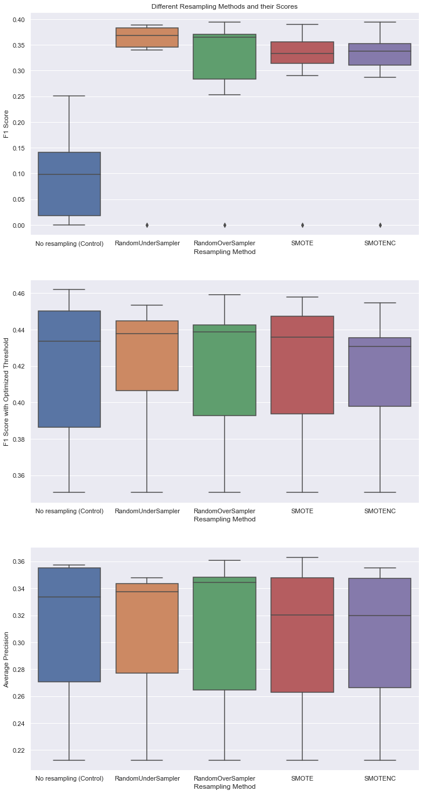
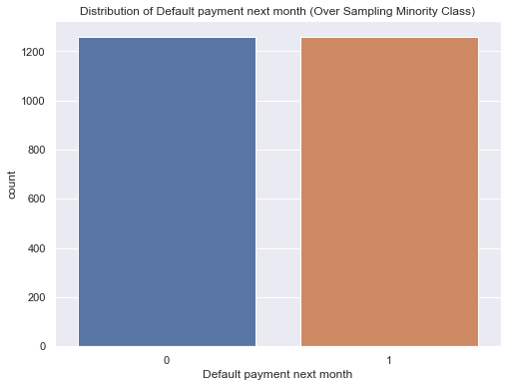
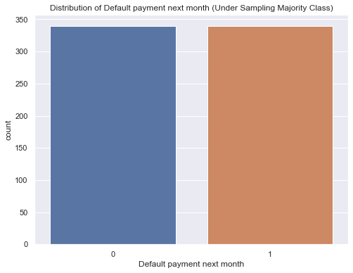
Model Selection: Resampling
Resampling Methods to compensate for Class Imbalance:
  RandomOverSampler
  RandomUnderSampler
  SMOTE
  SMOTENC
After comparing all 4 of these methods with the original data (no resampling) I conclude that RandomOverSampler is the best method since it has the highest median score for both threshold optimized F1 Score and Average Precision Score.
For all the evaluation I used Stratified KFold Cross Validation. This prevents overfitting of the model and ensures that the test set has the same distribution of target classes as the entire dataset
RandomOverSampler, SMOTE, and SMOTENC are all over sampling methods that increase the number of values in the minority class to match the majority class
RandomUnderSampler decreases the number of values in the majority class to match the minority class.

Slide 7
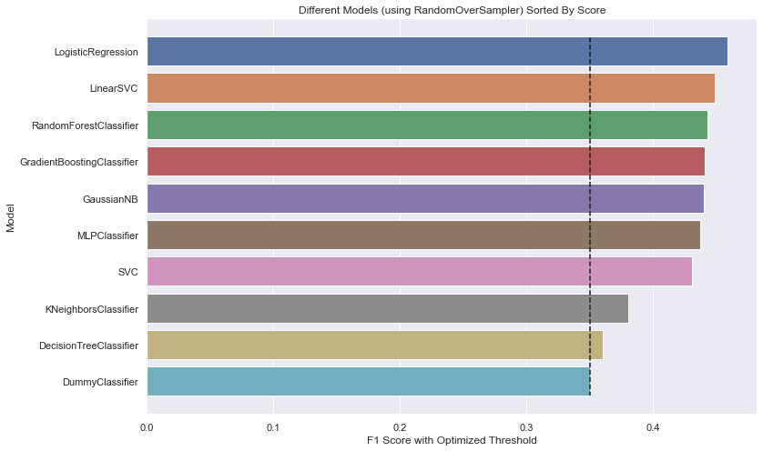
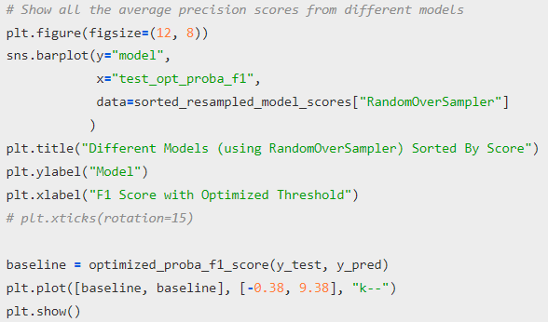
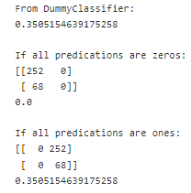
Model Selection
All models perform better than DummyClassifier
Best Performing Untuned Models: LogisticRegression, LinearSVC, RandomForestClassifier

Slide 8
Model Improvement: Hyperparameter Tuning
GridSearchCV
GridSearchCV exhaustively searches all the specified hyperparameter combinations within a predefined grid.
It evaluates and compares the performance of each combination and returns the best set of hyperparameters that maximize a chosen performance metric.
It is a brute-force approach that considers all possible hyperparameter combinations within the defined grid, which can be computationally expensive for large search spaces.
Artificial Bee Colony Algorithm
ABC is a nature-inspired metaheuristic optimization algorithm that mimics the foraging behavior of honeybees.
In ABC hyperparameter tuning, the algorithm creates a population of candidate solutions (representing different sets of hyperparameters) and iteratively improves them.
The algorithm uses the concept of employed bees, onlooker bees, and scout bees to explore and exploit the search space of hyperparameters.
Does not rely on exhaustive grid search but rather employs a population-based search and exploration strategy to find good hyperparameter configurations.

Slide 9
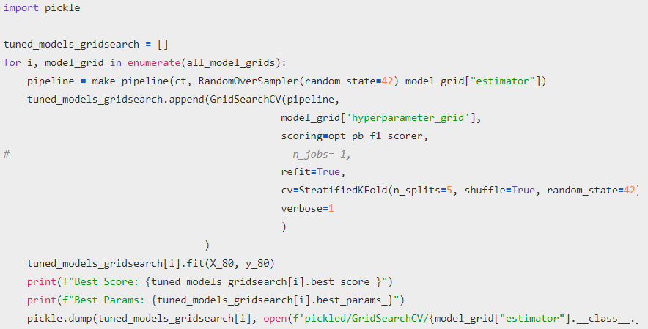
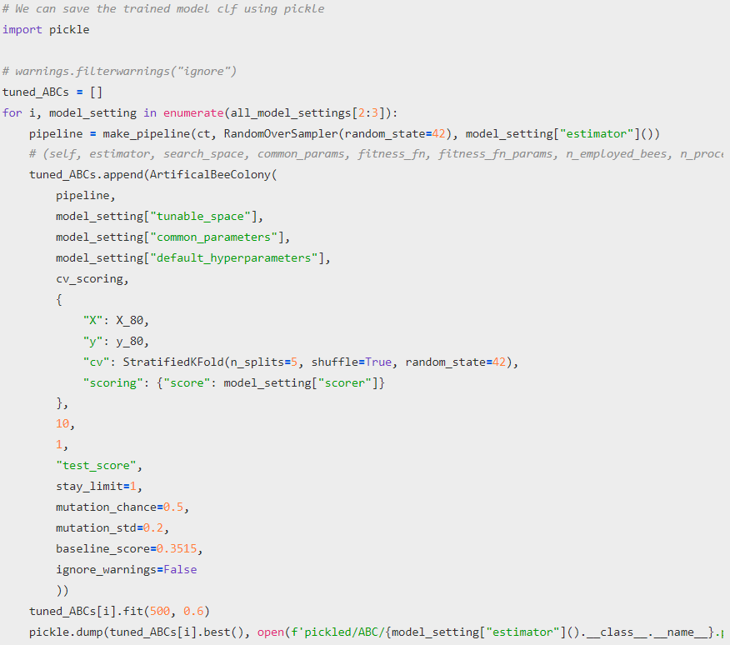
Model Improvement: Hyperparameter Tuning
GridSearchCV
Artificial Bee Colony Algorithm

Slide 10
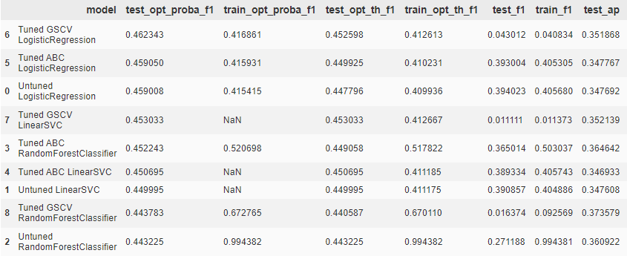
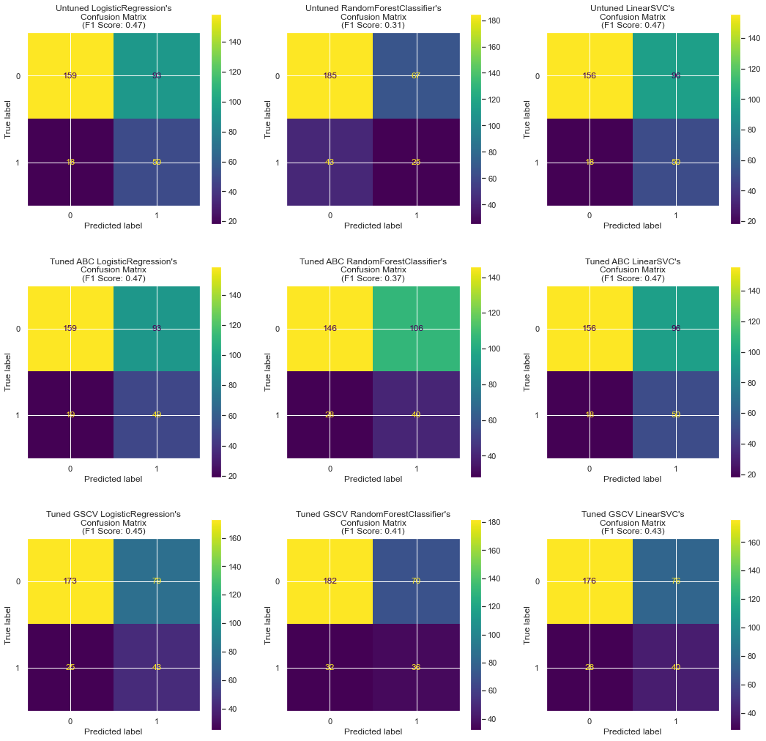
Model Improvement
Cross Validation Results:
Logistic Regression is the best performing overall model based on optimized F1 Score
Hyperparameter Tuning only improved the score of RandomForestClassifier
The optimized F1 Scores for the models tunes with GridSearchCV are generally higher than those from ArtificialBeeColony
Best model according to cross-validation: LogisticRegression Tuned using GridSearchCV

Slide 11
AIML CA1: Part B Classification
Name: Glenn Wu
Admin No.: 2214395
Class: DAAA/FT/2A/01

Slide 12
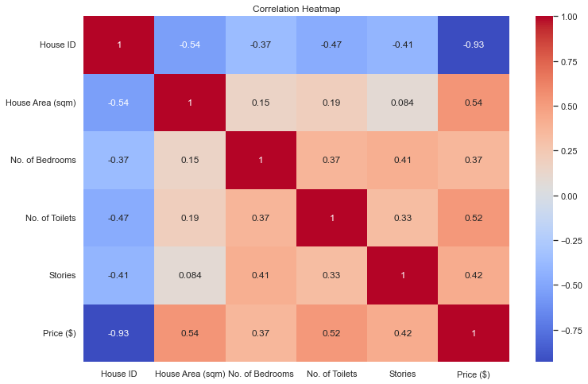
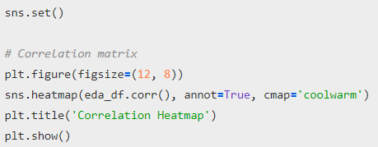
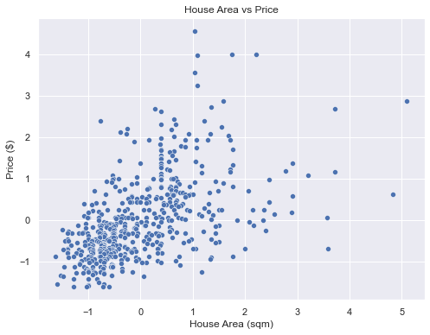
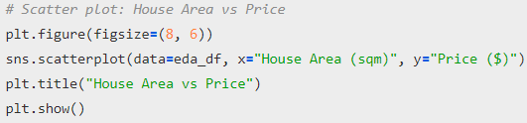
Data Exploration
The customer ID column is unique to each customer and independent from the rest of the columns, thus I will remove it.
House Area and Price have a positive correlation as seen in the Correlation Matrix and in the Scatterplot
There is some correlation between all the features and the target “Price ($)” which we are trying to predict, as a regression problem.

Slide 13
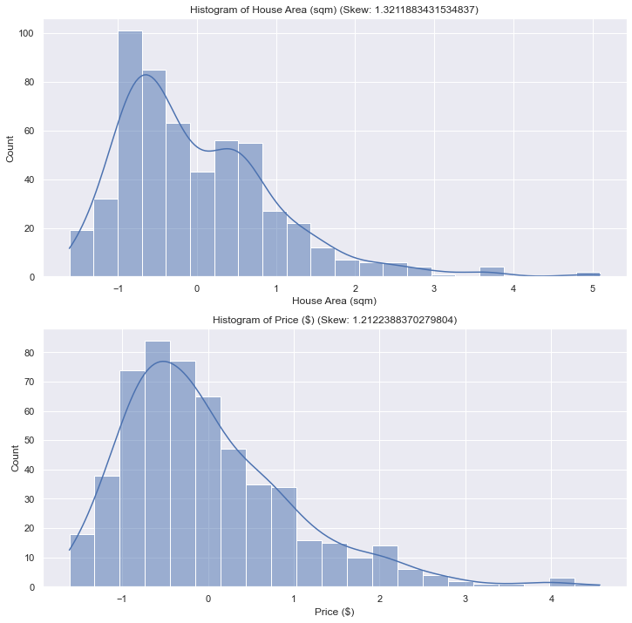
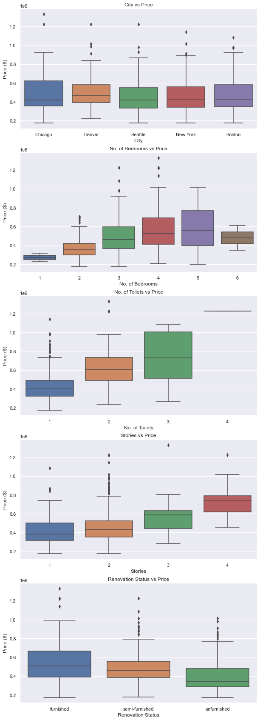
Data Exploration
Notable: Houses with 6 bedrooms are cheaper than houses with 4 bedrooms and more expense than houses with 3 bedrooms
Both House Area and Price are skewed to the right, with high skews. (>0.5)

Slide 14
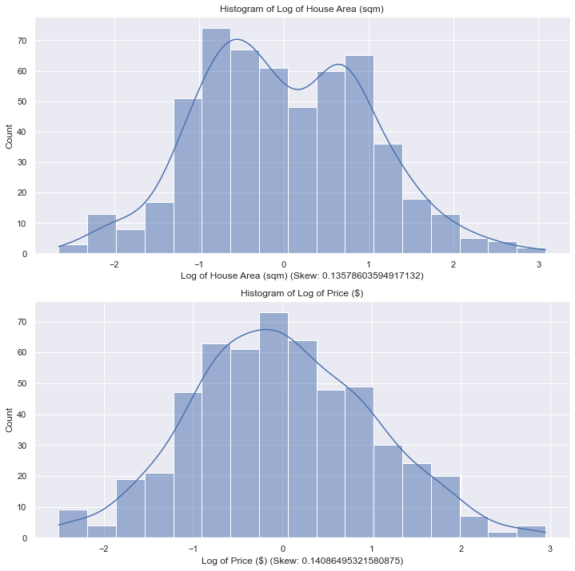
Feature Engineering
One Hot Encode “Cities”
Ordinal encode “Renovation Status” since it seems that houses with more furnishing are generally priced higher. (unfurnished > semi-furnished > furnished)
No. of Bedrooms, No. of Toilets, and Stories are already in an ordinal form, but I will encode them such that they start from 0 instead of 1.
I change the order of No. of Bedrooms such that 1 > 2 > 3 > 6 > 4 > 5
Both House Area and Price are skewed to the right, with high skews. (>0.5)
I use a Log transformation to unskew the data. (<0.5)
I also use a standard scaler within the pipeline after the Log transformation.

Slide 15
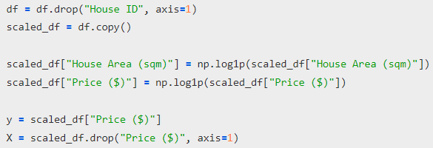
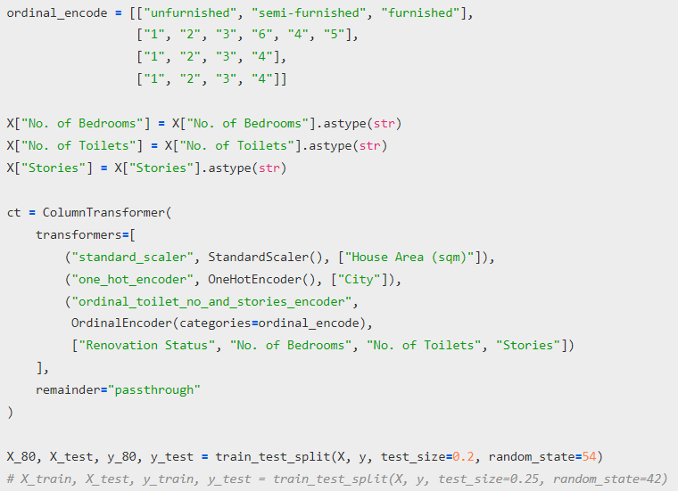
Feature Engineering
Log Transformation
Preprocessing Steps

Slide 16
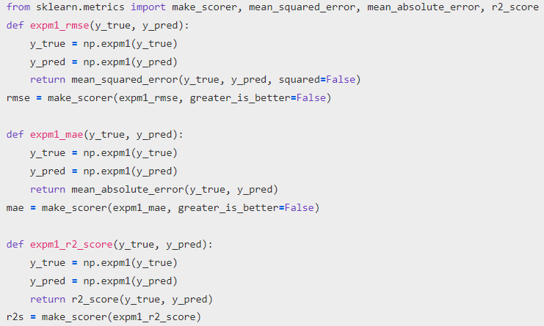
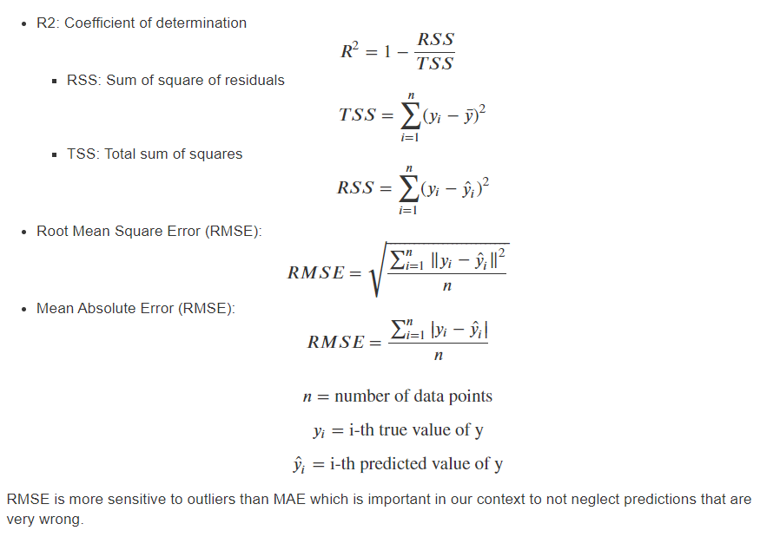
Model Selection
Scoring Metrics:
I have to create custom loss/score functions since “Price ($)” was Log transformed. So, to calculate the score I convert it back to the original form using exponents.

Slide 17
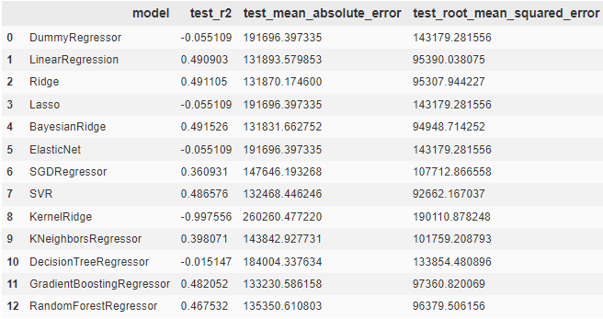
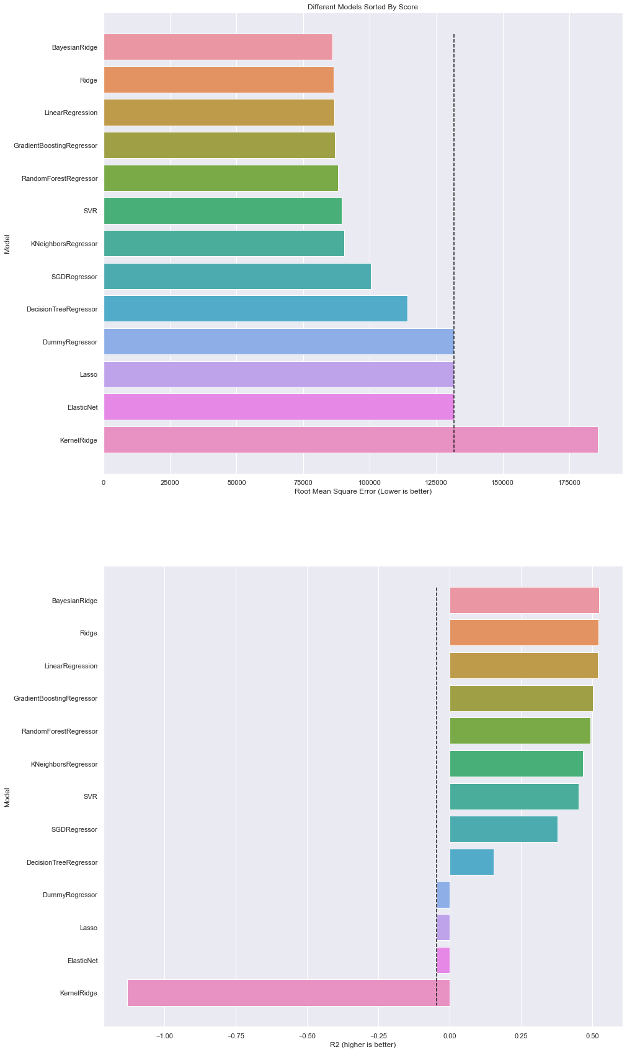
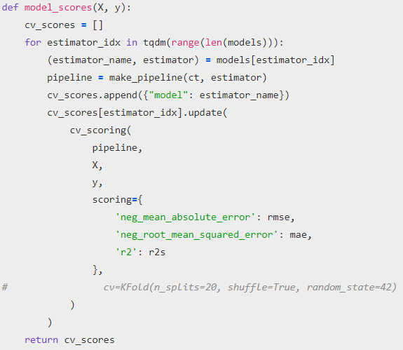
Model Selection
Untuned Models Ranked by RMSE and R2 respectively:
Baseline R2 from DummyRegressor: -0.04650839316728548
Baseline Root Mean Squared Error from DummyRegressor: 131734.69118270132
Best Untuned Models: BayesianRidge, Ridge, LinearRegression

Slide 18
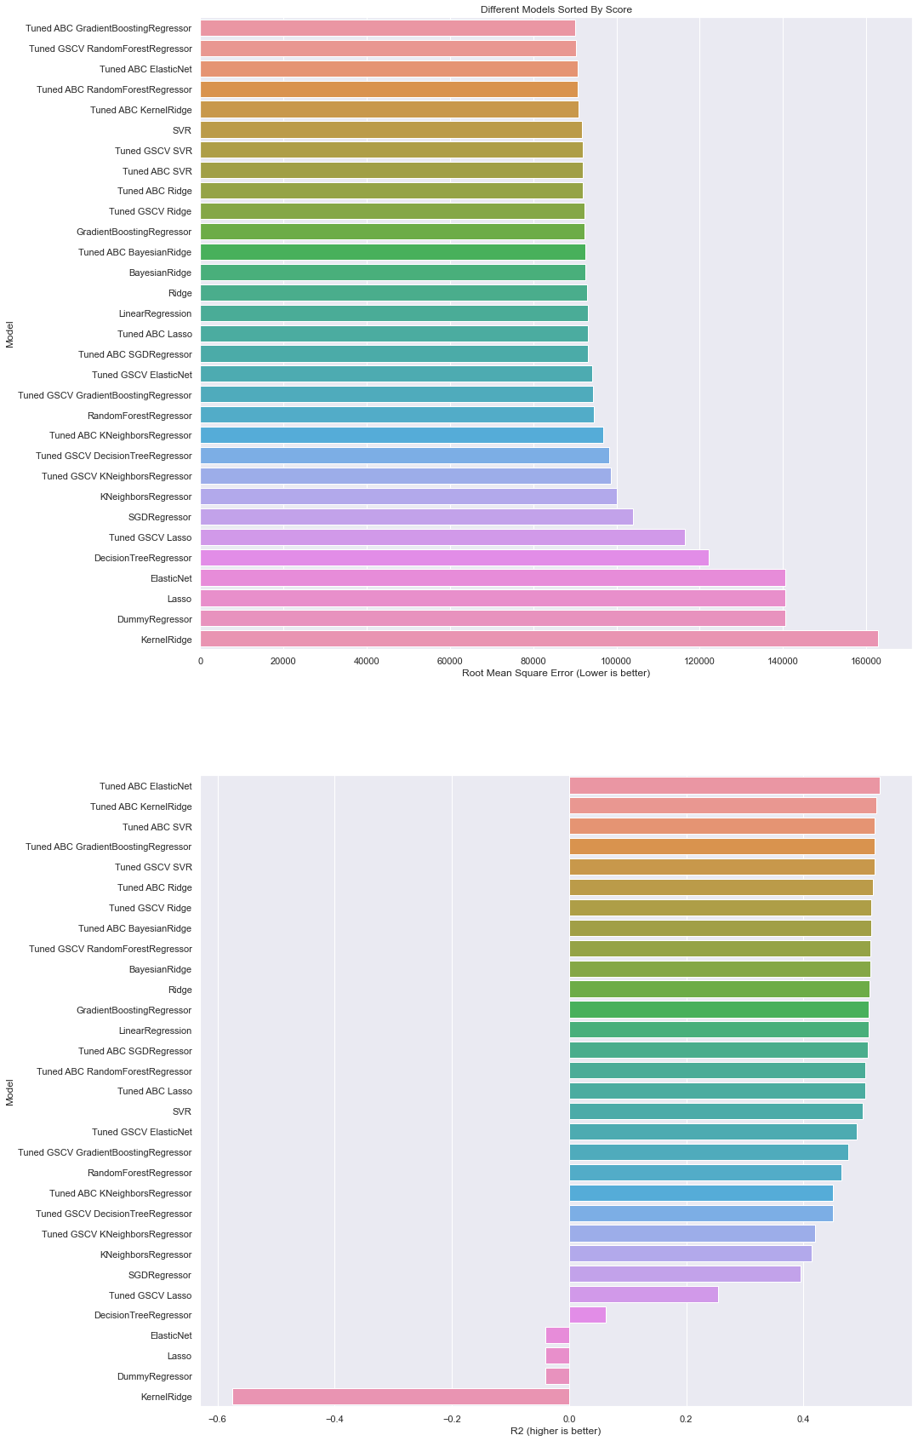
Model Improvement
Models tuned with ABC generally score higher than those tuned with GridSearchCV, except for RandomForestRegressor
Best model according to R2 score: GradientBoostingRegressor Tuned using ABC
Best model according to RMSE:
ElasticNet Tuned using ABC

Slide 19
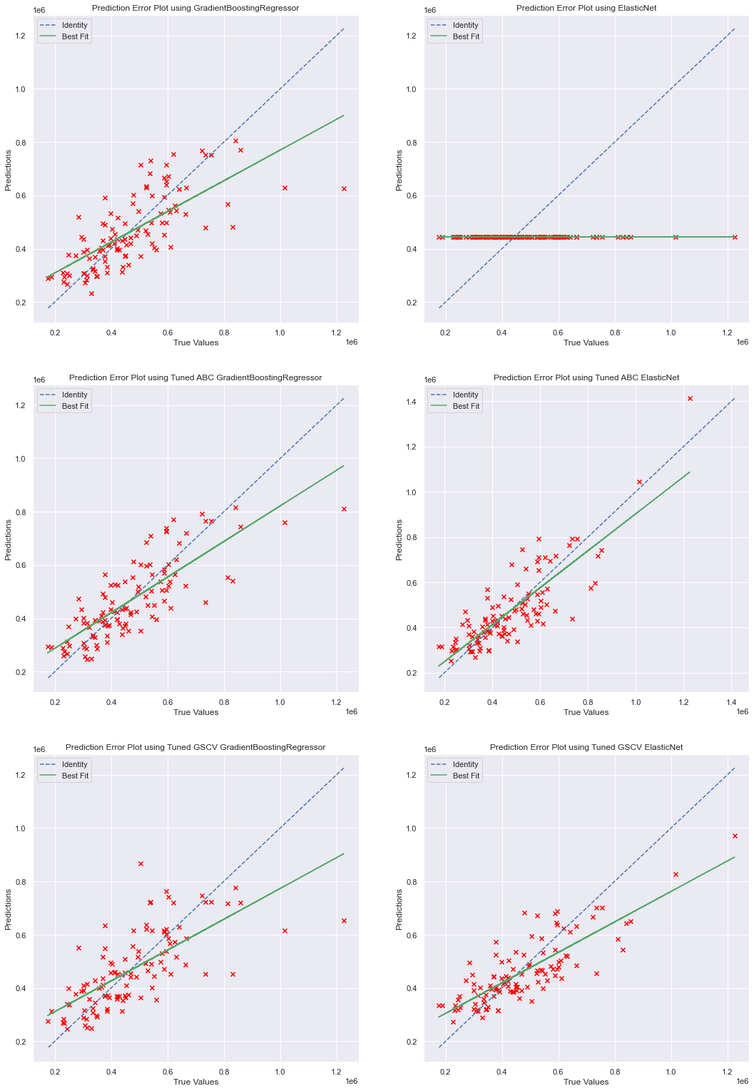
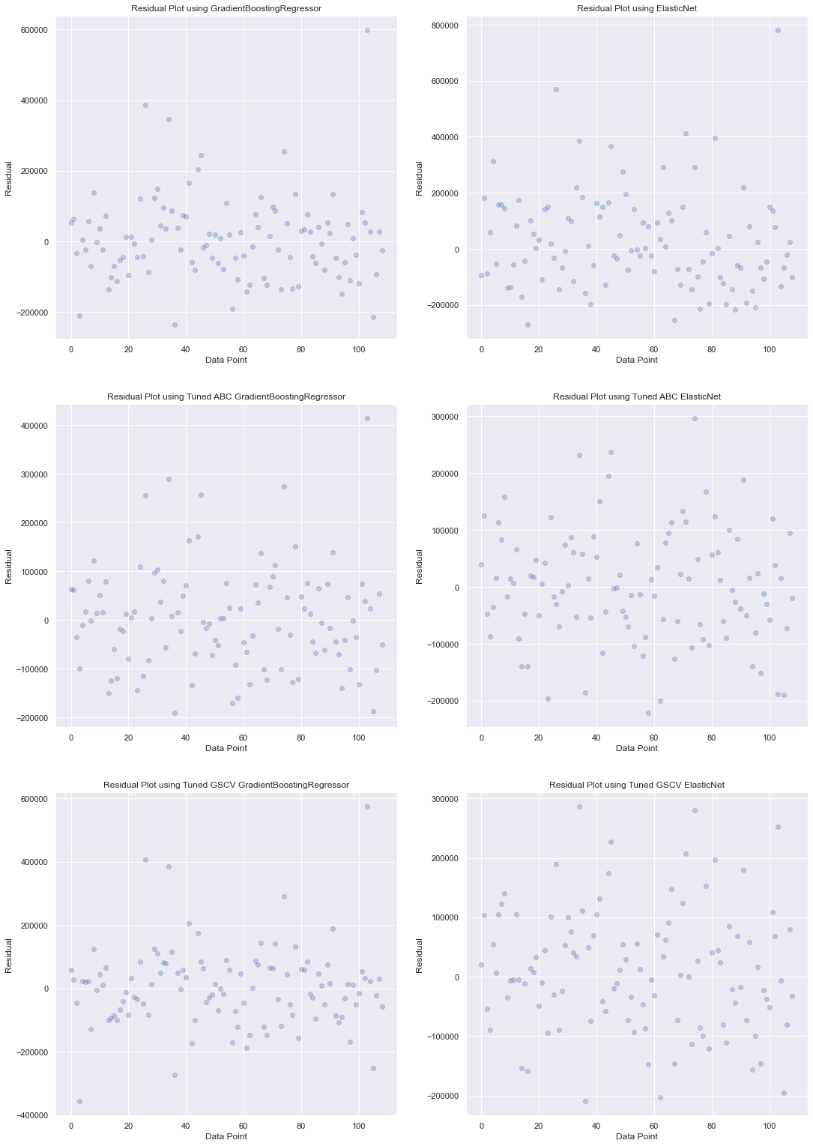
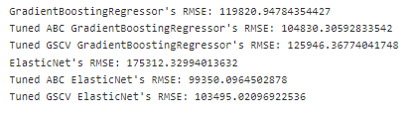
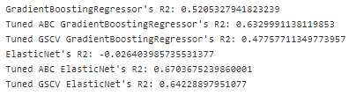
Model Evaluation
Hyperparameter Tuning is able to improve both R2 and RMSE scores
The Artificial Bee Colony Hyperparameter Tuning Algorithm is able to improve both the R2 and RMSE scores more than GridSearchCV
GridSearchCV is computationally wasteful since it tests all combinations of values inside the parameter grid even if similar combinations score badly while ABC is less computationally wasteful since it focusses on hyperparameter combinations that are similar to combinations that it has already scored well.
ABC is also not restricted to a discrete parameter grid, I only provide it an upper and lower bound of values for integers and floats. This means that it can find a set of parameters that are better than those inside a fixed grid.
Tuned ABC ElasticNet is the best performing based on both R2 score and RMSE. The Prediction Error Plot is very close to the ideal.

Slide 20
Conclusions
Hyperparameter Tuning is able to improve both R2 and RMSE scores
The Artificial Bee Colony Hyperparameter Tuning Algorithm is able to improve both the R2 and RMSE scores more than GridSearchCV
GridSearchCV is computationally wasteful since it tests all combinations of values inside the parameter grid even if similar combinations score badly while ABC is less computationally wasteful since it focusses on hyperparameter combinations that are similar to combinations that it has already scored well.
ABC is also not restricted to a discrete parameter grid, I only provide it an upper and lower bound of values for integers and floats. This means that it can find a set of parameters that are better than those inside a fixed grid like GridSearchCV requires.

